Slide 1
HOTEL APPLICATION

Slide 2
System Analysis :
The hotel application is an application which is help the receptionist to save the reservations data in Hotel database. It also can show the reservation data of the hotel reservation.

Slide 3
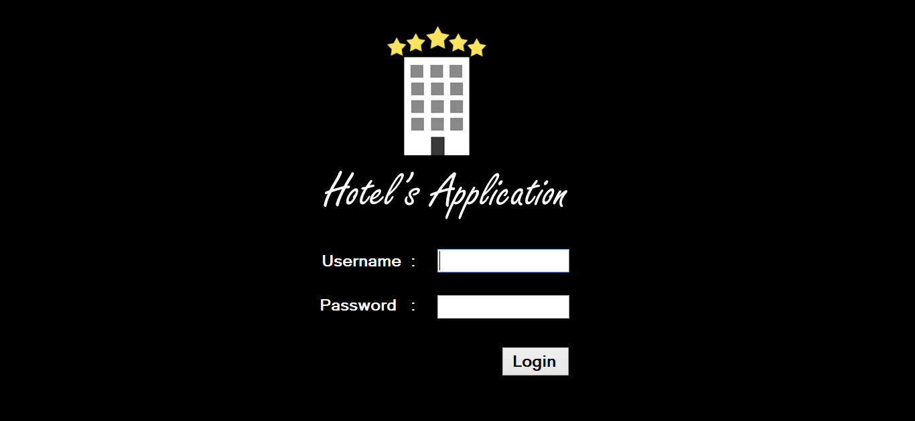
Interface design for Hotel Application
Login Panel of Hotel Application

Slide 4
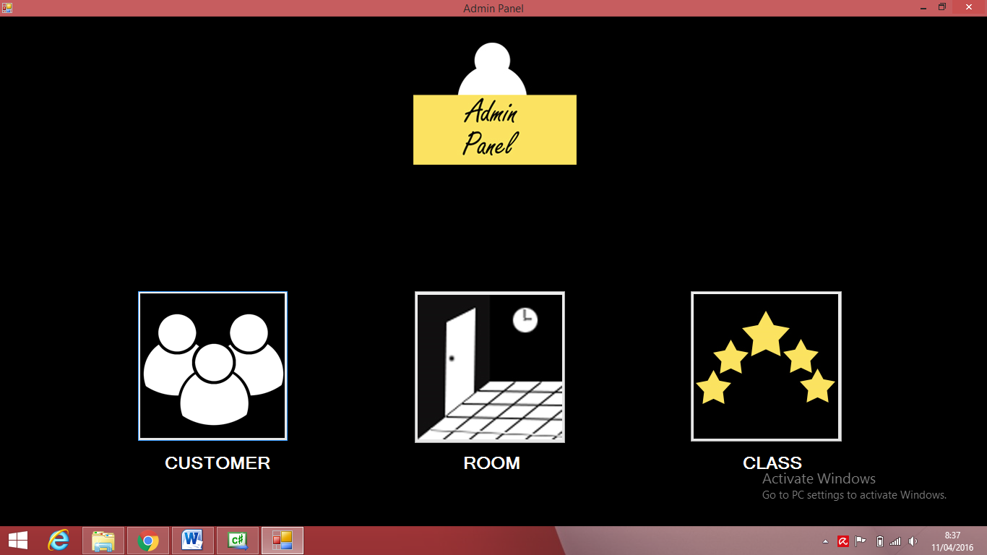
Admin panel

Slide 5

Thank You

